Slide 1

Data Analysis-Immo Eliza
Monisha Kumari Hitang
Learner at Becode

Slide 2
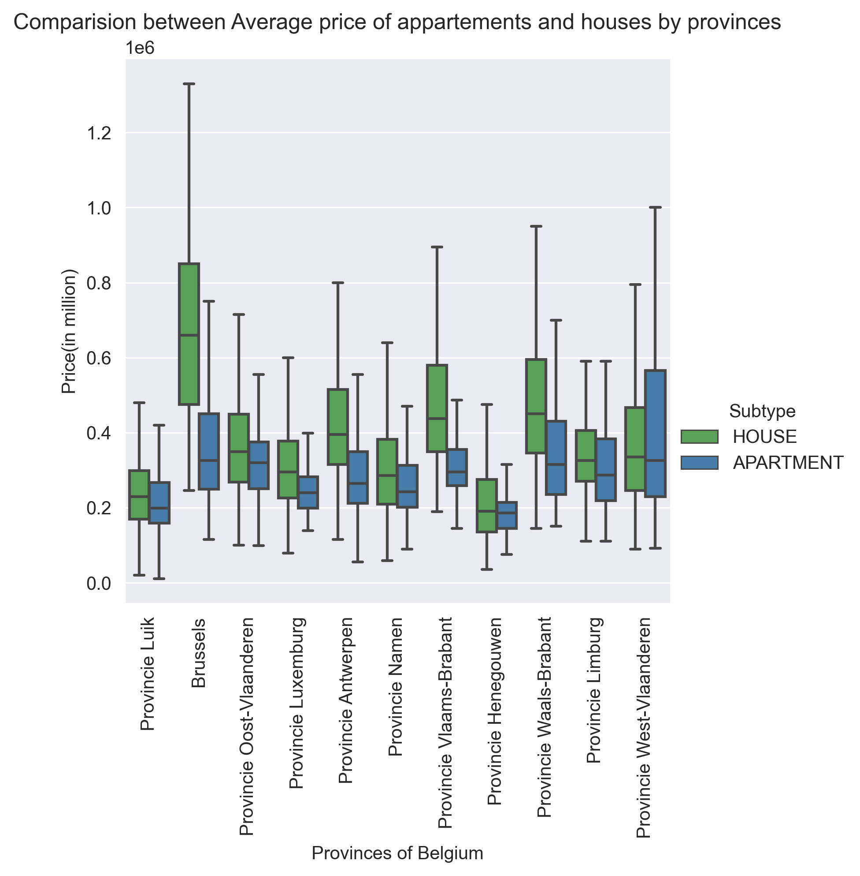
Relationship between house and apartment prices based on provinces in Belgium

Slide 3
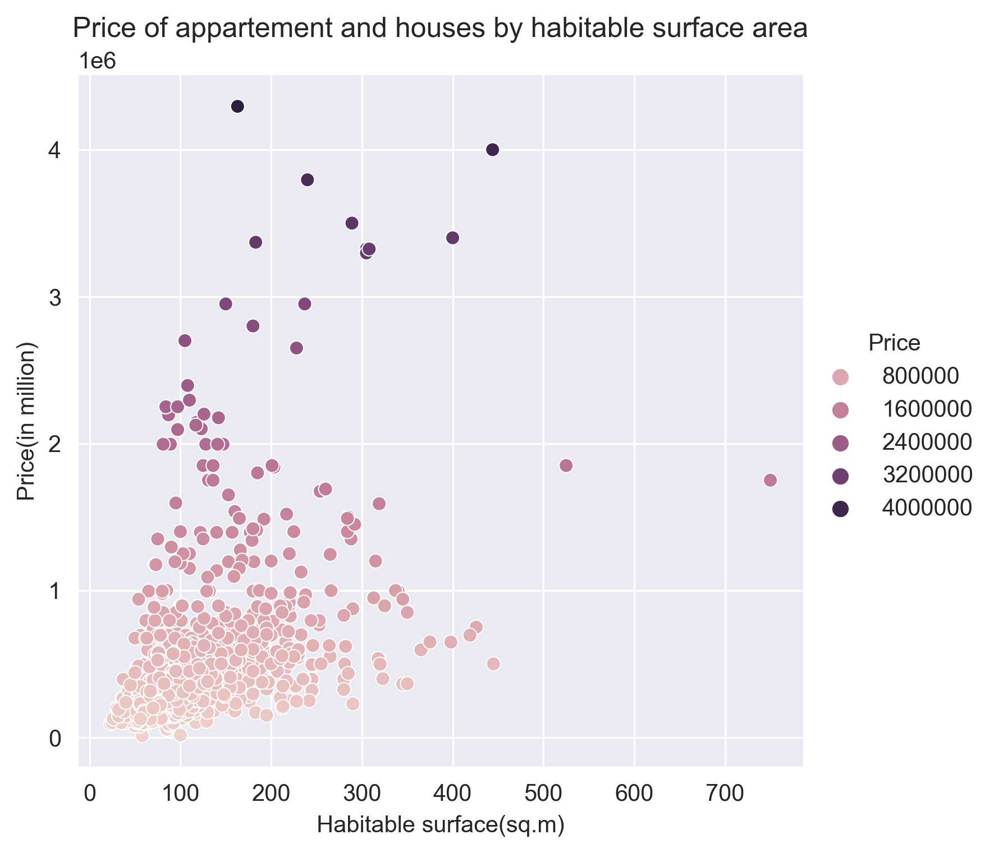
Relationship between house and apartment prices based on Habitable Surface Area

Slide 4
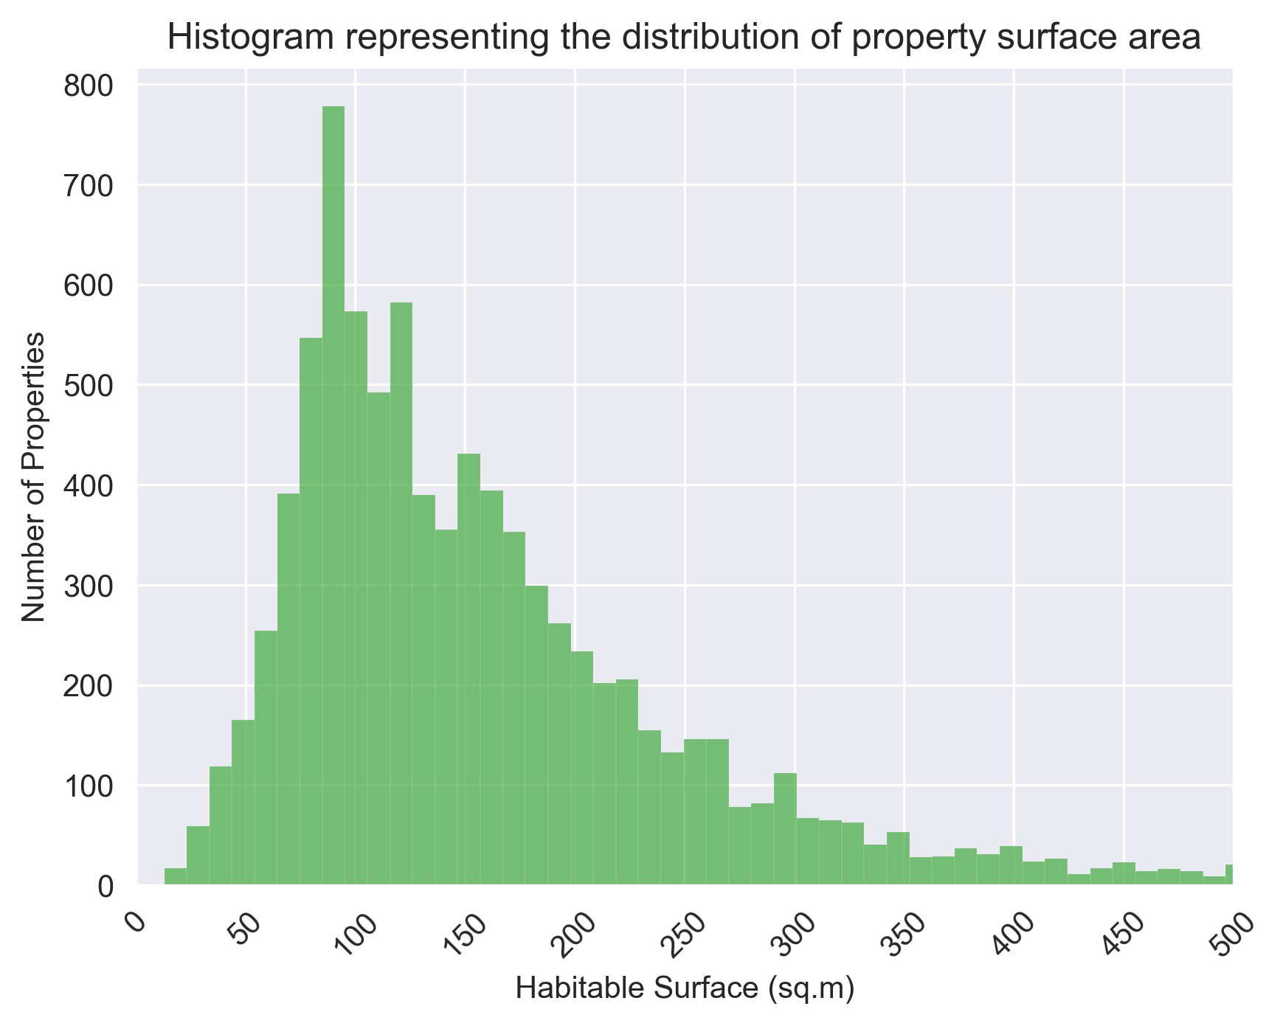
Relationship between Number of properties based Habitable Surface

Slide 5
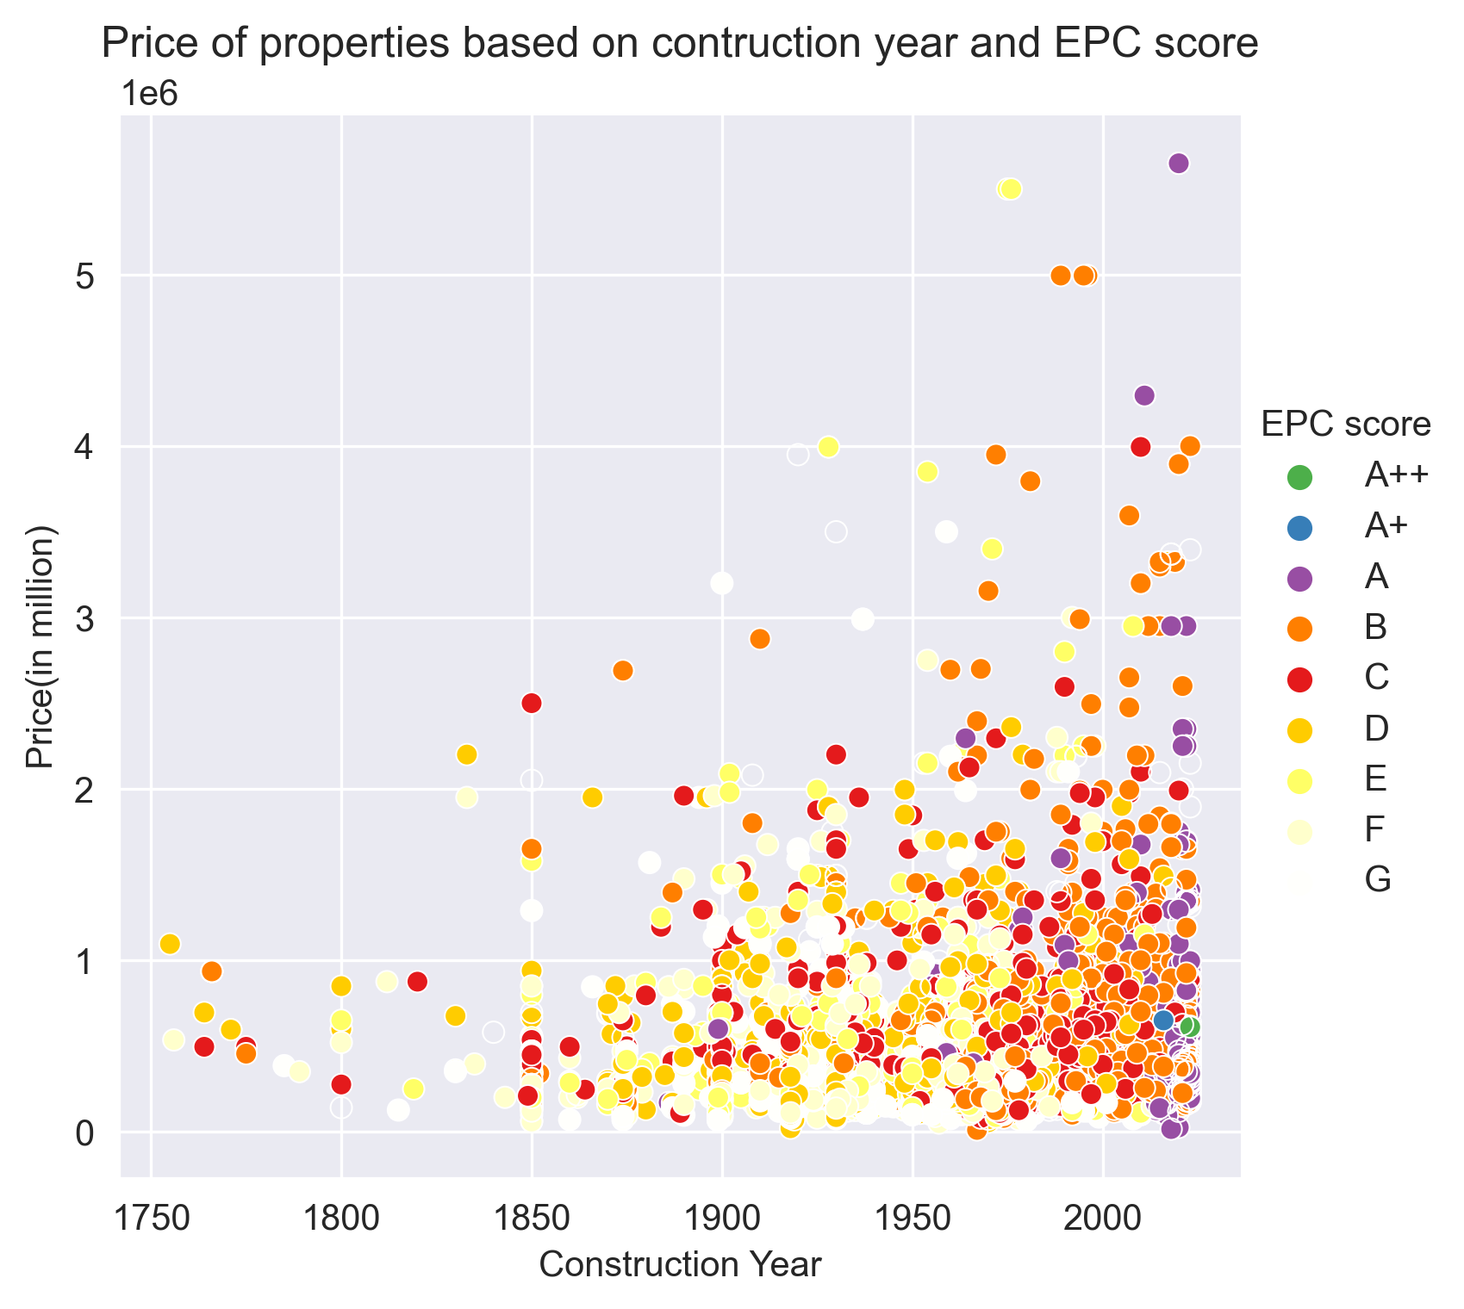
Relationship between prices of properties based Construction Year

Slide 6
Thank You!

